Slide 1
An Introduction to Cellular Concrete and Advanced Engineered Foam Technology for Grouting Applications
Not just products…Solutions
Richard Palladino
President June 20, 2013

Slide 2
A brief history of cellular concrete
Invented in Sweden – used commercially across Scandinavia
Hydrolyzed, protein-based foam liquid concentrates introduced
Synthetic-based foam liquid concentrated introduced
Feature highly-stable air cells with extended maximum life in the plastic state – excellent longevity and durability
Feature relatively stable air cells and acceptable density control
End of WWII 1945
Early 1900’s
1990’s
2000’s
Introduction of hybrid foam liquid concentrates – mixture of protein and synthetic ingredients
Technology gained traction throughout Europe and much of the rest of the globe
Pervious Cellular Concrete Patent Approved

Slide 3
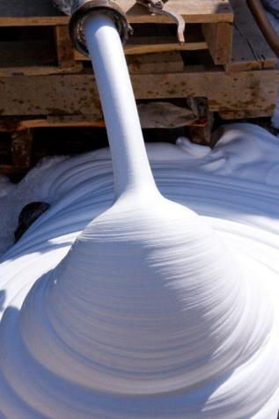
Low-density cellular concrete is defined by ACI 523 as…
Concrete made with hydraulic cement, water and
preformed foam to produce a hardened material with an oven dry density of 50 pounds (22.7 kg) per cubic foot or less.

Slide 4
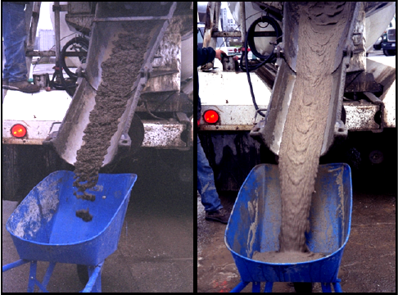
Conforms to ACI industry standards
Types of Foam
Preformed
Produced by Foam Generator
Agitated
Produced by the mixing action of a concrete mixer
ACI 523
ACI 229

Slide 5
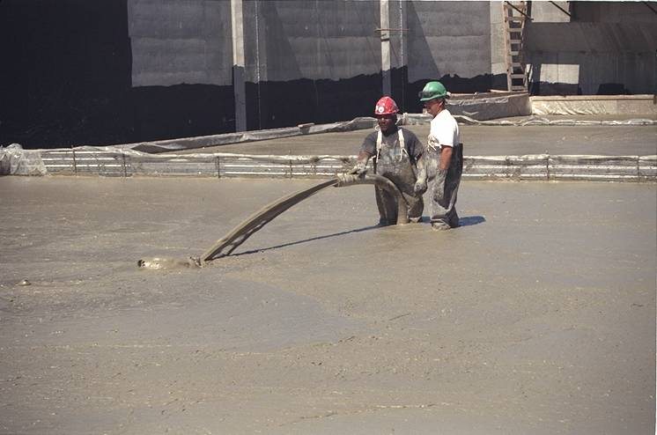
Cellular concrete replaces traditional fine or coarse aggregate with AIR
The air cells must be strong and resilient in order to withstand the rigors of mixing and pumping to the point of placement
Foam has the stability to be calculated as a solid

Slide 6
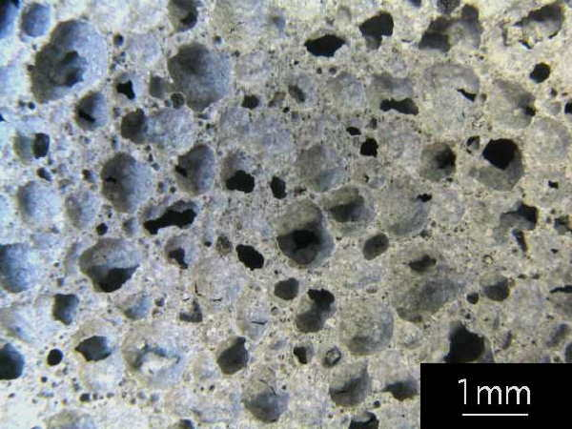
Cellular concrete pore structure when cured
Cementitious materials encapsulate the air bubbles, then dissipate leaving a void structure as a replacement to traditional aggregate
Cellular Concrete differs from conventional aggregate concrete in the methods of production, the density of the material and the extensive range of end uses.

Slide 7
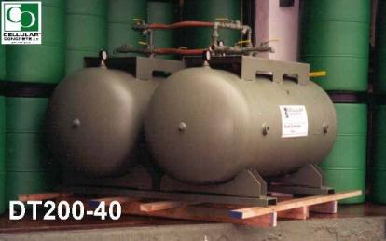
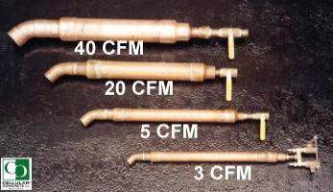
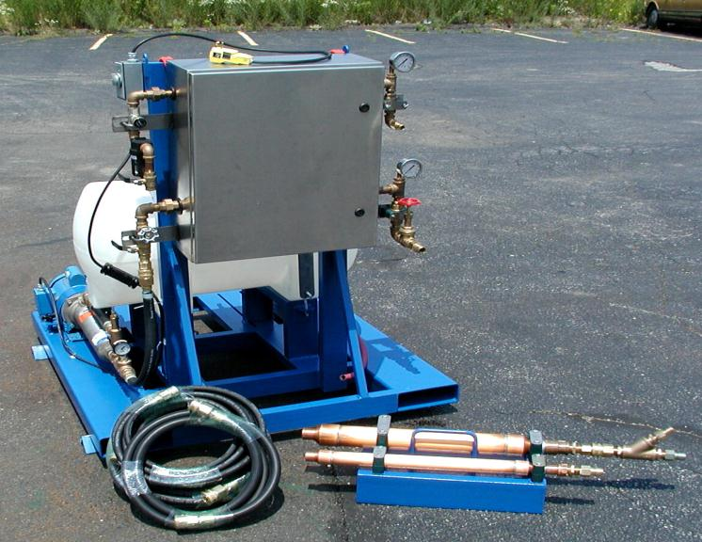
There are two types of foam generating systems
PRESSURE TANK GENERATING SYSTEMS
Foam liquid concentrate and water premixed in a tank
Solution then discharged from pressurized tank through foam-making nozzle
No additional water pump is required – process completed by air pressure alone
CONTINUOUS GENERATING SYSTEMS
Auto foam system – continuously draws solution directly from container
Automatically blends concentrate with water and compressed air in
fixed proportions

Slide 8
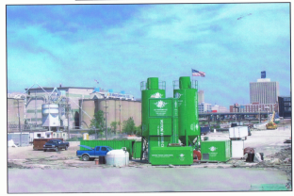
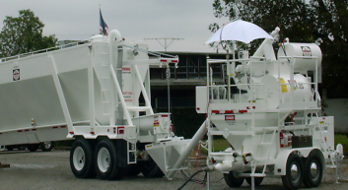
Types of on-site installation equipment include
High production self-contained unit for larger volume projects
Mobile Mixing units
Self-contained trailer wet batch system

Slide 9
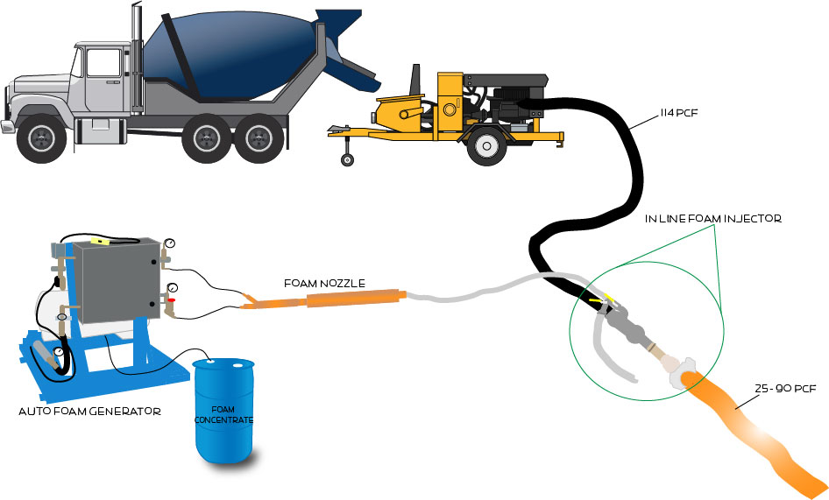
cellular concrete batching process 1 cy of Slurry expands up to 4.6 cy

Slide 10
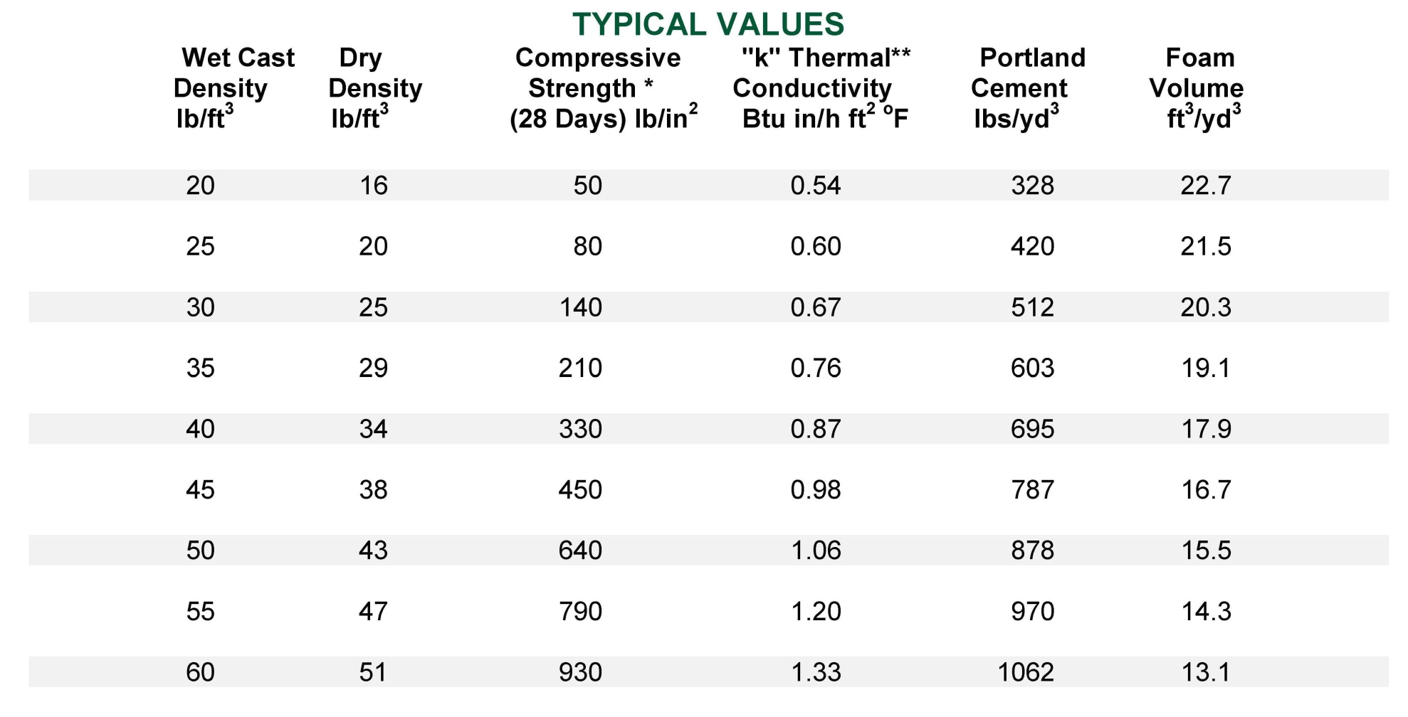
strength and density properties of no sand cellular concrete mixes

Slide 11
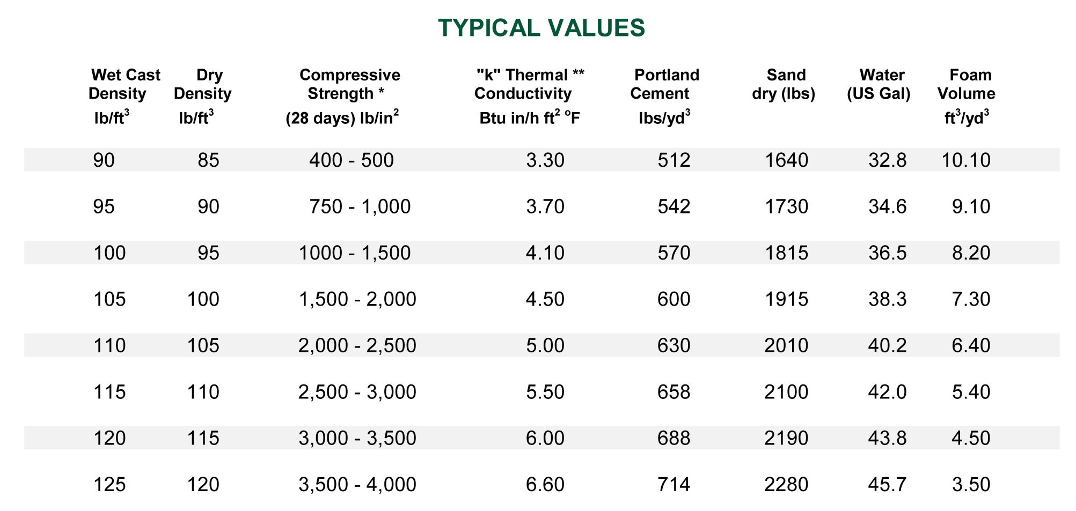
strength and density properties of sanded cellular concrete mixes

Slide 12
Cellular concrete follows ASTM test methods that apply to lightweight insulating concrete
ASTM C 495
ASTM C 796
“Standard Test Method for: Compressive Strength of Lightweight Insulating Concrete”
“Standard Test Method for: Foaming Agents for use in Producing Cellular Concrete using Preformed Foam”
Cylinder specimens are 3”x6”
50% relative humidity curing
Air dried for 3 days before testing
28 day compressive strength testing
Handling and storage of samples is very important

Slide 13
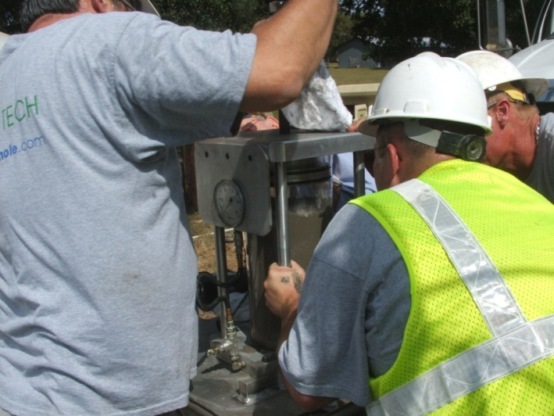
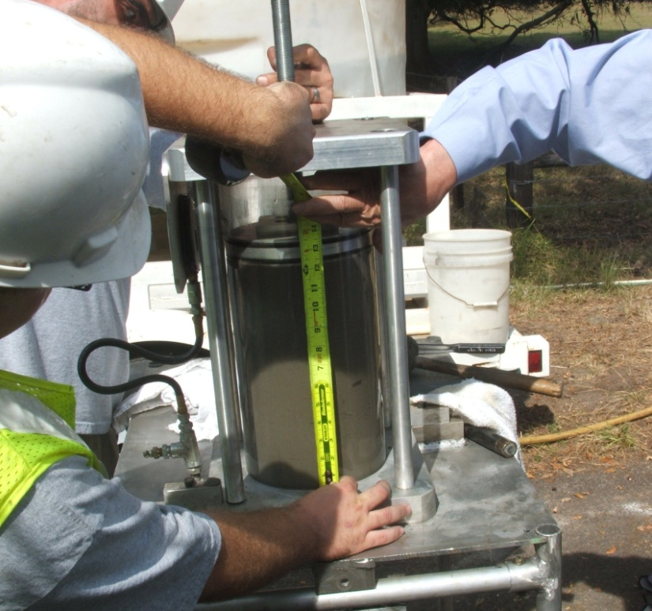
Compressibility testing on cellular concrete validates ability to resist bubble collapse from pressure
Compressibility device to evaluate stability of Cellular Concrete – Would the air bubbles collapse and not recover?
Note: The clear cylinder limits the pressure that can be applied, as does the loading by turning a screw through a threaded top plate. However, the grout is tracked through the pump during calibration, so the test acts as confirmation of the cellular concrete performance that is observed during pumping.
The grout level was 12 inches at zero pressure
*Information provided by
Ardaman & Associates, Inc. Tampa, FL

Slide 14
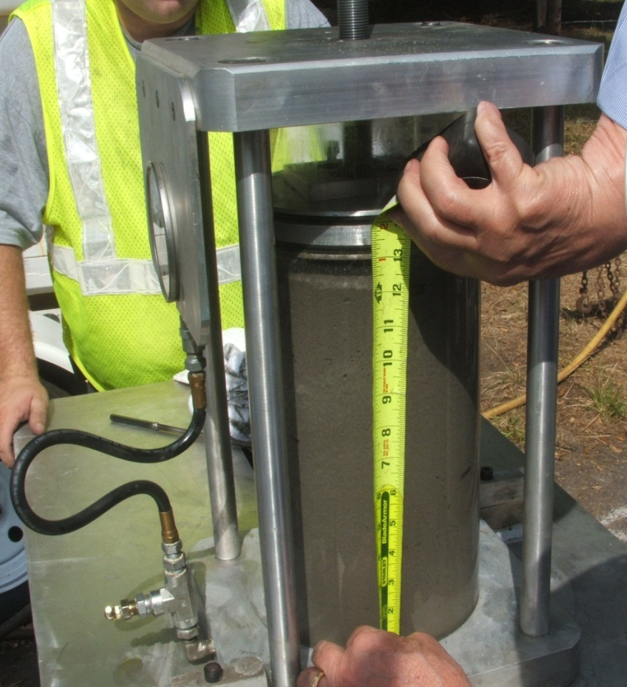
The cellular concrete fully rebounded to the original fill height
At 30 psi pressure, the cellular concrete was reduced in height to 9 inches
*Note there was no visible release of air or water from the cellular concrete after the test.
*Information provided by
Ardaman & Associates, Inc. Tampa, FL

Slide 15
Foam technology has made huge advancements with stable bubble technology For Grouting Applications
Typical Foams
3 foot lift thickness
Pumping Distance limited to 5,000 feet maximum
Closed Cell
Slump 8 inches up
Fly Ash Limited
Advanced Engineered Foam Technology
8-20 foot lift thickness
Pumping Distance increased to more than 15,000 feet
Closed / Open Cell
Slump 2 inches up
Higher Fly Ash usage
Increased stability

Slide 16
Grouting for Geotechnical Applications
Annular Grout for Tunnels, Water & Sewer Lines
Tunnel Arch Backfill
Tunnel Backfill and Annular Fills
Subgrade Modification
Fill Underground Tanks & Pipelines
Fill for Abandoned Mines
Tremie Applications
Bridge Approach & Landslip Repair
Retaining Wall Backfills

Slide 17
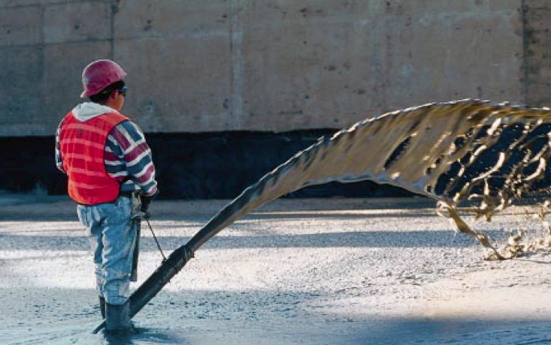
Cellular concrete is an ideal solution for annular and tunnel backfill
Highly flowable material able to completely fill annular space
Lightweight and easily pumped long distances at low pressures
Will not float pipe or damage liner for sliplining
Cellular Concrete has been pumped over 700 feet vertically and over 15,000 feet horizontally
Strength and density can be customized to project requirements
Shrinkage of less than 0.3%
Quick and Easy Installation
Environmentally Safe
Can accommodate any diameter pipe

Slide 18
Grouting for Geotechnical Applications
Annular Grout for Tunnels, Water & Sewer Lines
Tunnel Arch Backfill
Tunnel Backfill and Annular Fills
Subgrade Modification
Fill Underground Tanks & Pipelines
Fill for Abandoned Mines
Tremie Applications
Bridge Approach & Landslip Repair
Retaining Wall Backfills

Slide 19
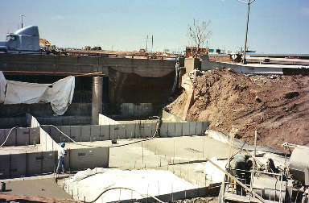
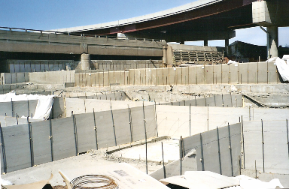
Use cellular concrete for subgrade modification when existing soils are undesirable
Cellular Concrete Advantages
Reduce Vertical Dead Loads
Increase Strength/Stability with Minimal Weight
Insulating
Improve Seismic Stability
Reduce Settlement Potential
Increase Bearing Capacity
Lightweight cellular concrete for unstable soils at the Newark Airport

Slide 20
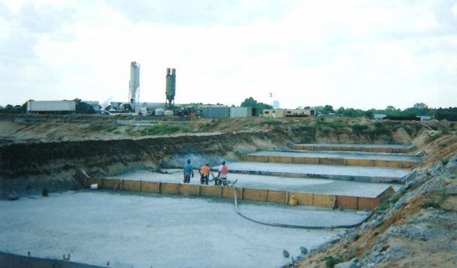
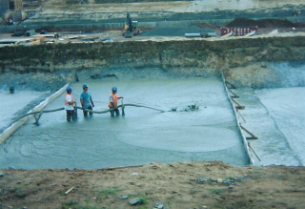
Cellular concrete used to replace unstable soils at the University of Connecticut
Football stadium constructed on a landfill site with unstable soils
Lightweight Cellular Concrete sub-base equally distributed the loads
40,000 yds of 35pcf material placed at 150 cy per hour

Slide 21
Grouting for Geotechnical Applications
Annular Grout for Tunnels, Water & Sewer Lines
Tunnel Arch Backfill
Tunnel backfill and annular fills
Subgrade Modification
Fill Underground Tanks & Pipelines
Fill for Abandoned Mines
Tremie Applications
Bridge Approach & Landslip Repair
Retaining Wall Backfills

Slide 22
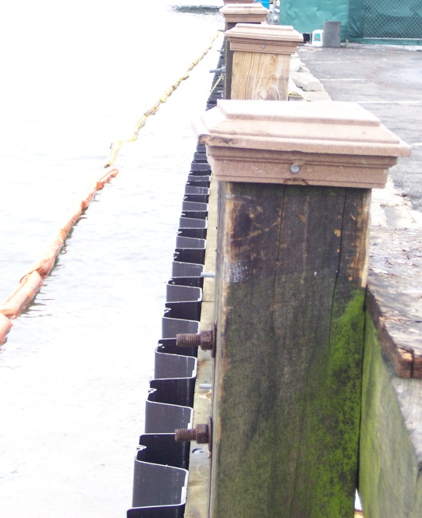
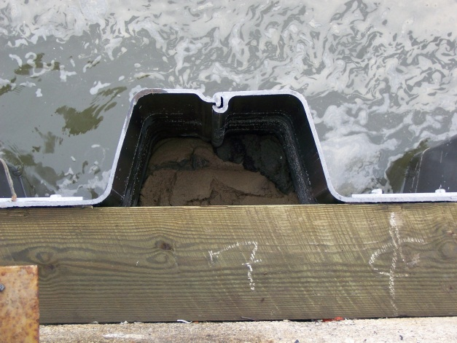
The fluidity of cellular concrete makes it favorable for tremie applications
Coastal piers compromised by bugs
Placed sheet pile around existing piers, to isolate wood from water
70 pcf Cellular Concrete used as fill between the sheet pile and the pier
Moving military bases from Japan to Guam
Seawall needed to be reinforced
Backfill behind seawall with lean cement/heavy sand mix
Cellular Concrete material moved 35’ in each direction from tremie location

Slide 23
Grouting for Geotechnical Applications
Annular Grout for Tunnels, Water & Sewer Lines
Tunnel Arch Backfill
Tunnel backfill and annular fills
Subgrade Modification
Fill Underground Tanks & Pipelines
Fill for Abandoned Mines
Tremie Applications
Bridge Approach & Landslip Repair
Retaining Wall Backfills

Slide 24
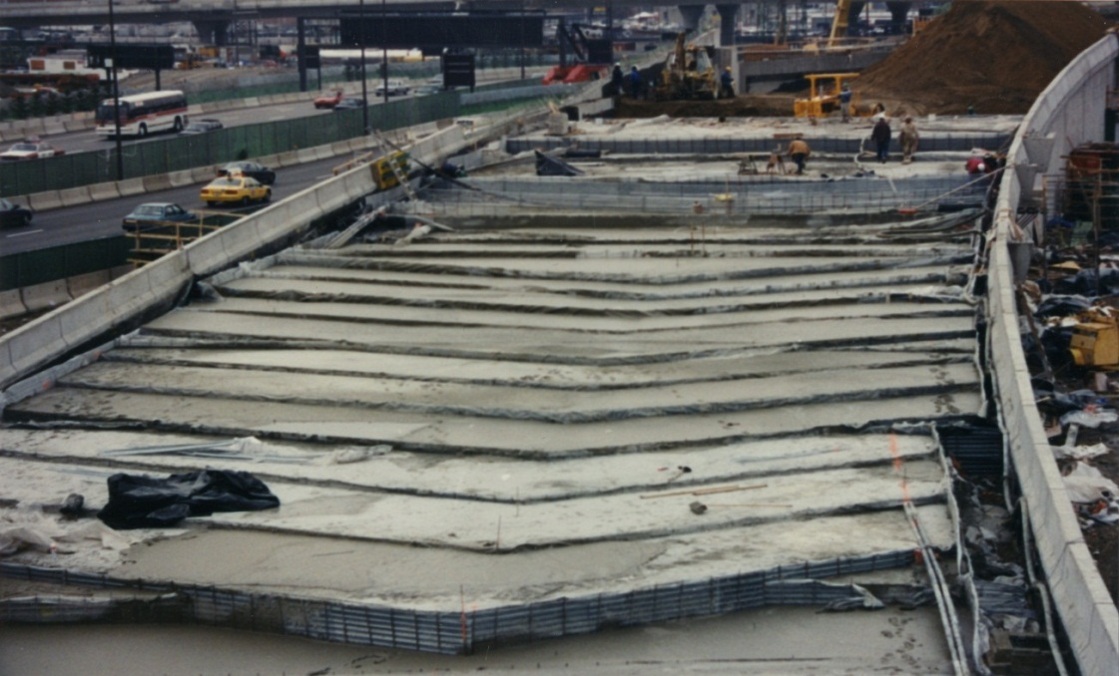
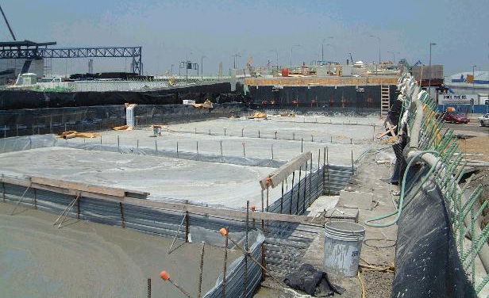
Cellular concrete is ideal for the construction/rehab of bridge approaches
Permanent Sub-base
Load Reduction on Approaches
Ease of Placement
Durability and Longevity
CALTRANS LA Bridge Approach
Boston- Logan Airport
Bridge Approach

Slide 25
Grouting for Geotechnical Applications
Annular Grout for Tunnels, Water & Sewer Lines
Tunnel Arch Backfill
Tunnel backfill and annular fills
Subgrade Modification
Fill Underground Tanks & Pipelines
Fill for Abandoned Mines
Tremie Applications
Bridge Approach & Landslip Repair
Retaining Wall Backfills

Slide 26
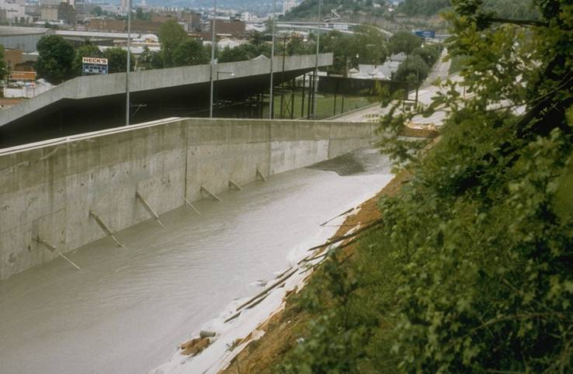
Cellular concrete is ideal Grout for retaining wall backfill
Cellular Concrete Advantages
Reduce Lateral Load
Ease of Placement
Increased lift heights
Reduces schedule impact
Allows for design flexibility
Engineered Permeability

Slide 27
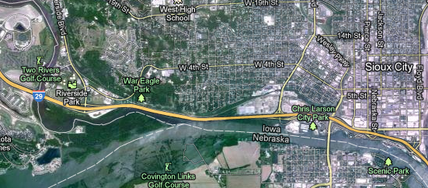
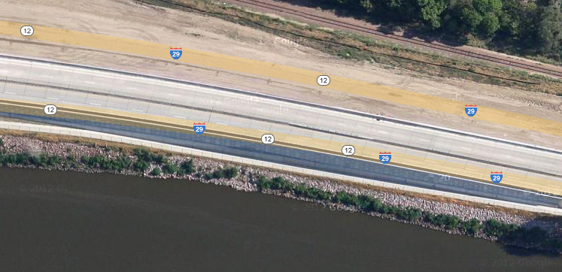
River scouring out embankment on I-29 threatened safety of motorists
Big Sioux River

Slide 28
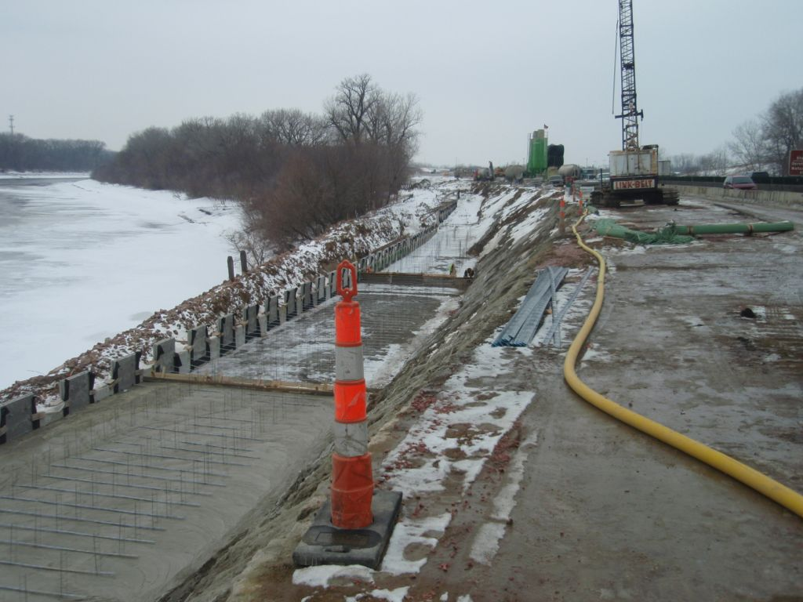
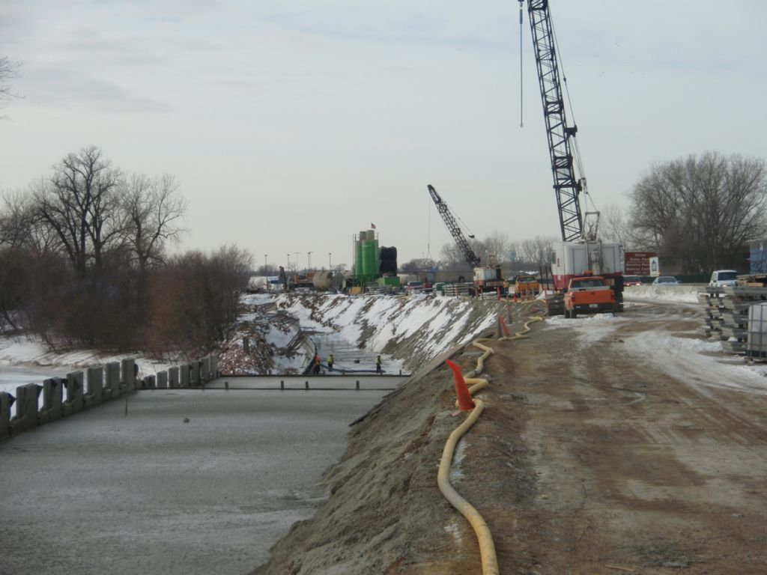
Using cellular concrete on this project allowed for a shortened schedule on the backfill of the wall system
Mix Design: 35 pcf 80 psi
Pumped 2,800 feet
Limitation: MSE Wall Straps Placed at 2’ vertical spacing

Slide 29
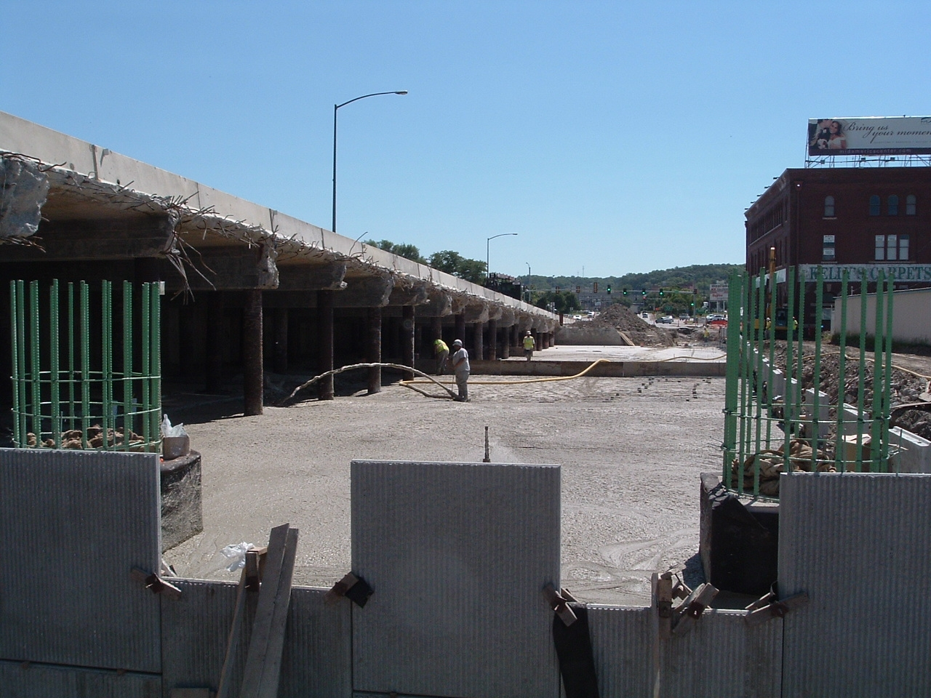
Cellular concrete lightweight Grout alternative for MSE wall backfill on bridge approach
Highway________, Council Bluffs, IA
Existing soils were soft and sandy, could not handle weight of traditional compacted fill

Slide 30
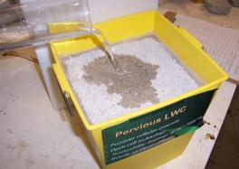
Emerging Technologies and Engineered Foam Solutions
Pervious Cellular Concrete
Open Cell Technology
Permeability Drainage of 30” -1000”/hr
Density of 25pcf – 45pcf
Foam Transport of Fill Materials
MTSU testing shows that 97% of oil and 79% of heavy metals were retained in the sample

Slide 31
Typical uses and applications for pervious cellular concrete
Sports Complex – Field Drainage
Retaining Wall Backfill
Pervious Pavement – sub-base filtration
Foundation Drainage
Pipeline Bedding / Culvert Fill
Landscaping
Pool Backfill
Attendees & Experts Choice 2007

Slide 32
Pervious cellular concrete used as a sub-base at the New York Mets Ballpark saving the owner over $500,000 dollars
The site of the new ball park was on poor soils. Pervious Cellular Concrete was used as a sub-base under the playing field area to allow for drainage.
The original design called for 4’ of lightweight aggregate. Cellular Concrete was proposed as a value engineering alternative.

Slide 33
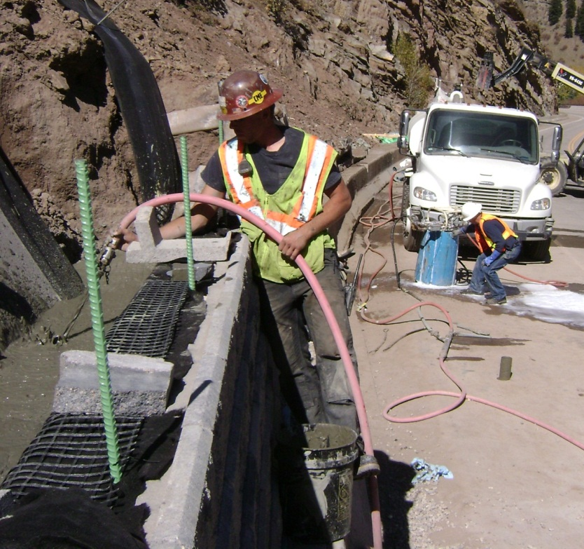
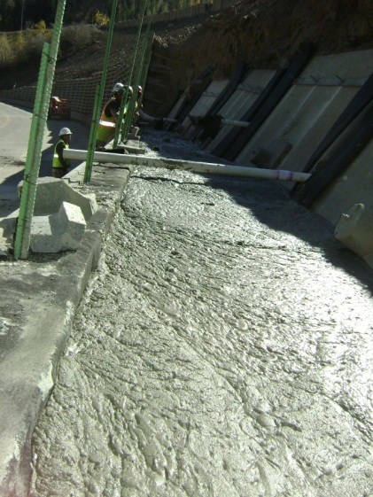
Pervious cellular concrete used for retaining wall backfill to provide drainage at toe of landslide
I-70
Pervious fill behind lower bin wall
LANDSLIDE
US 6
Due to the close proximity of the retaining wall to the concrete block anchors installed to tie back the landslide, the lightweight pervious backfill reduced the lateral earth pressure on the new block wall while still allowing for proper draining, which is key to reducing the potential for future slope failure

Slide 34
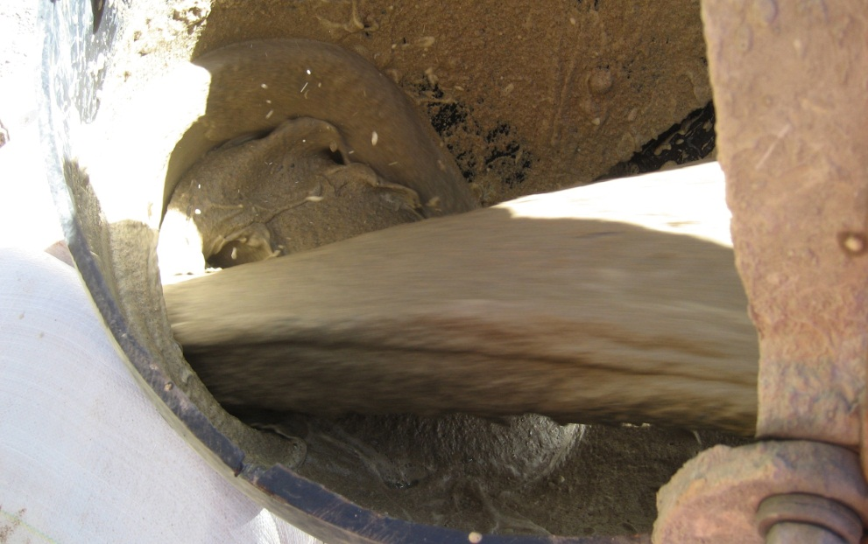
Emerging Technologies and Engineered Foam Solutions
Foam Transport of Fill Materials
Traditional fill materials and tailings transport uses WATER as the transport medium
Foam Technology involves the introduction of AIR BUBBLES to replace the water as the main transport medium
Provides a less expensive and Environmentally friendly alternative

Slide 35
Water usage in foam transport of fill materials is dramatically reduced
1 Cubic Yard of Material
Water Transport
50% Material 50% Water
Foam Transport
50% Material 50% Foam
101 Gallons Water
4 Gallons Water

Slide 36
Principals and benefits of foam transport technology
Air Weighs Less than Water
Foam uses Less Energy than water as a transport medium
Foam is Generated on site
Eliminates the need to pump in, haul, or treat water
Foam reduces abrasion on the pipeline due to internal friction
Foam is biodegradable
Material particle size can be as large as 3/4 inch

Slide 37
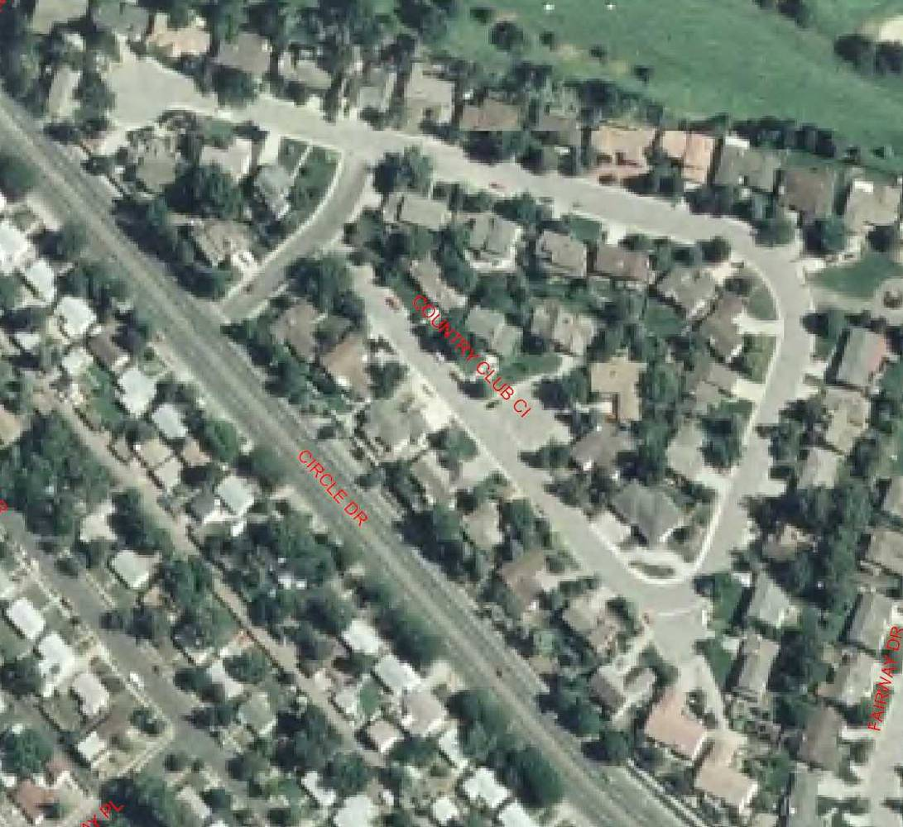
Foam transport was used successfully in a mine Grouting reclamation project for the State of Colorado
Project Location:
Country Club Circle Subdivision
Colorado Springs, Colorado

Slide 38
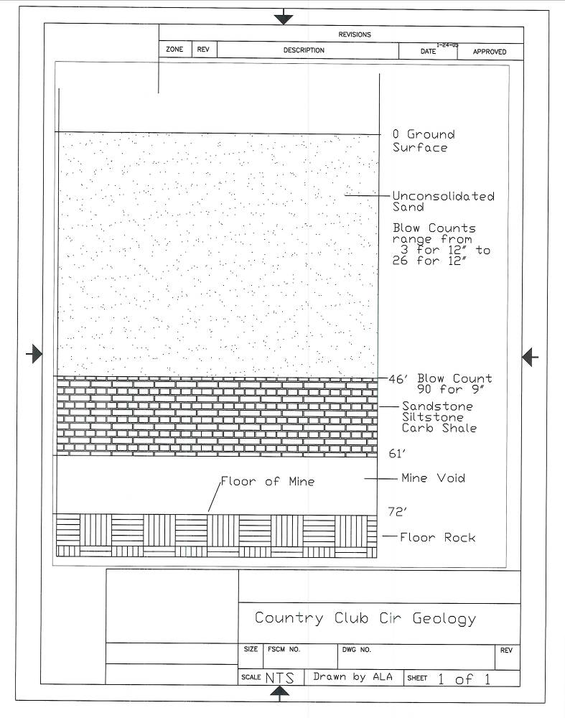
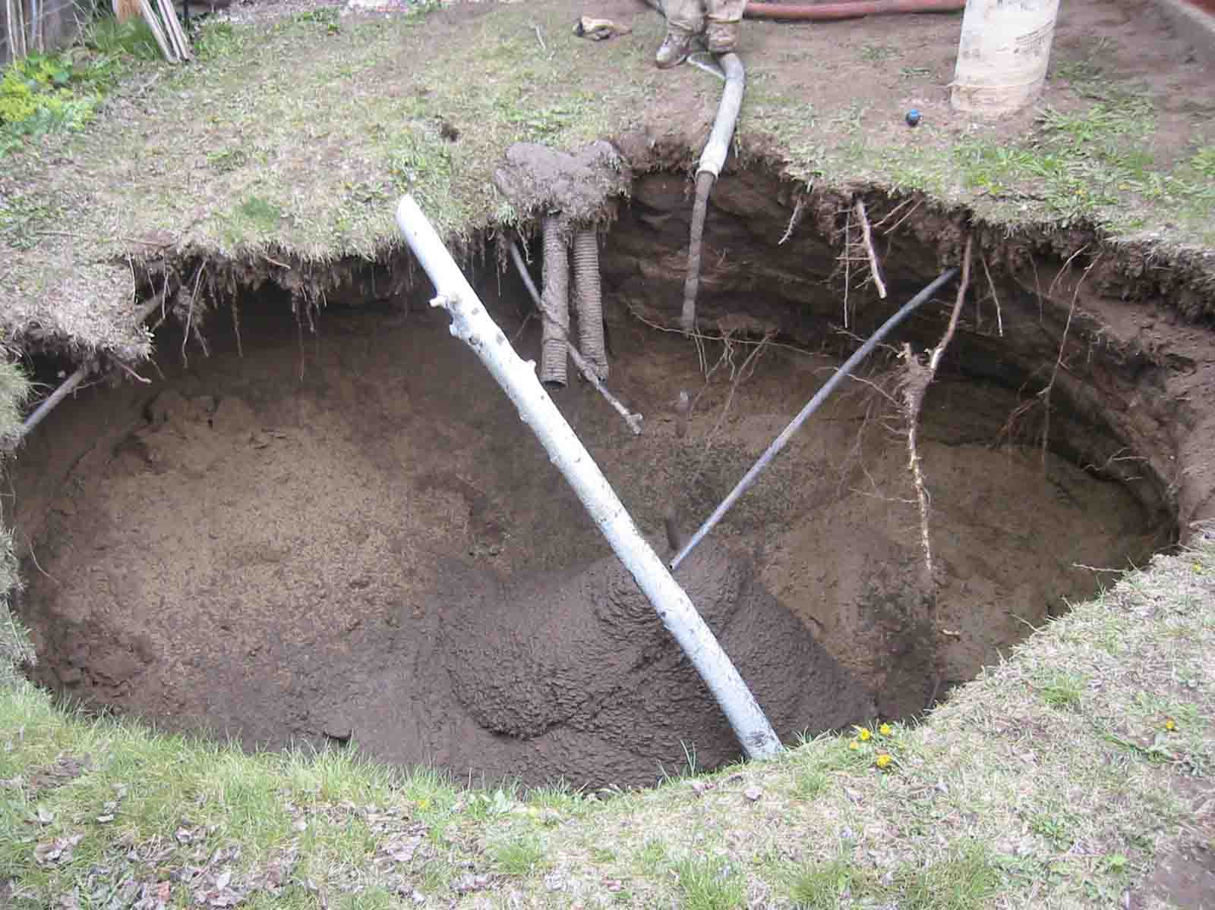
The subdivision had experienced several subsidence events that caused significant damage, indicating large voids
Damage from 2005 subsidence event
The strata in the sub-division consists of about 45’ of sand over 15’ of rock
The coal mine created 8’ to 9’ of void space

Slide 39
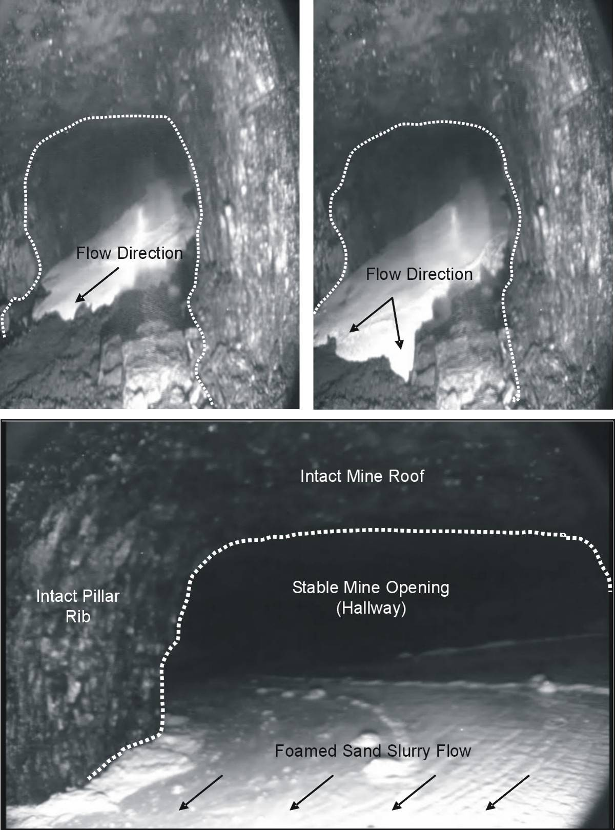
Large voids were found and evaluated using borehole camera, sonar scanning, and cross hole tomography
In May 2009, 267 cubic yards of a foamed sand slurry was injected into open mine entry
Borehole camera images show foamed sand slurry flowing through the voids
Figure 12 – Video Images in Borehole CCC13 During Foamed Sand Injection in Borehole CCC6

Slide 40
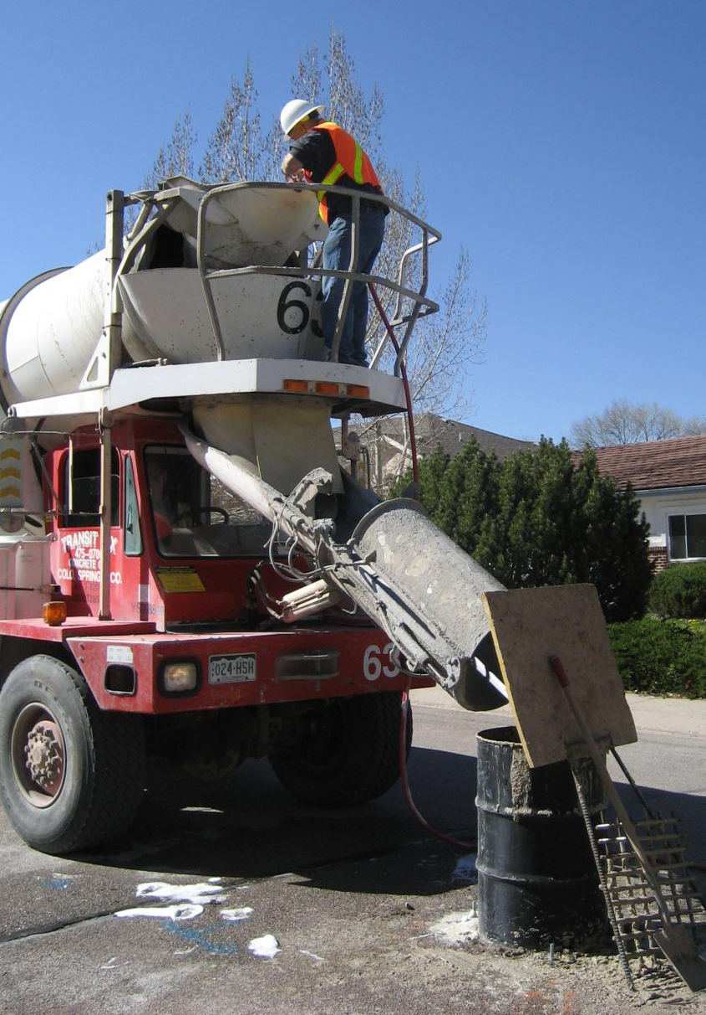
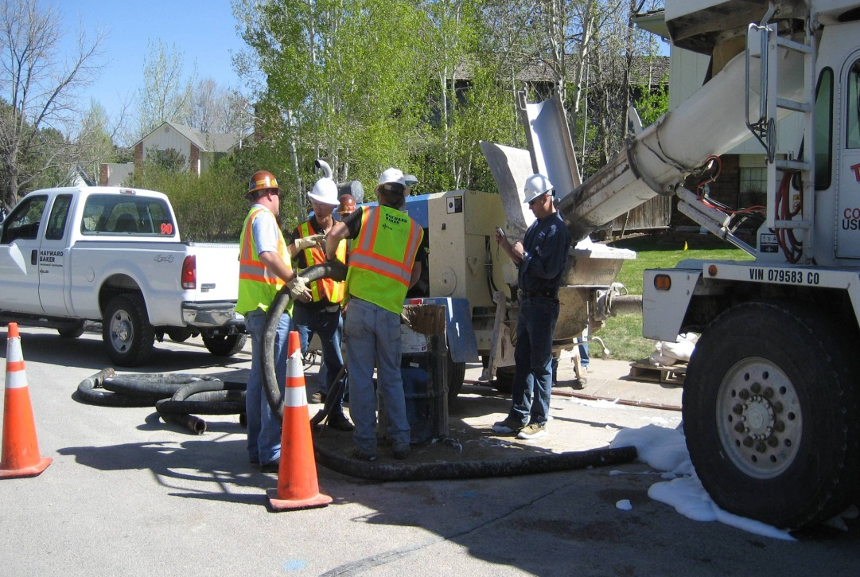
Foam technology allows for an accelerated schedule with low material costs

Slide 41
Video of Foam Transport

Slide 42
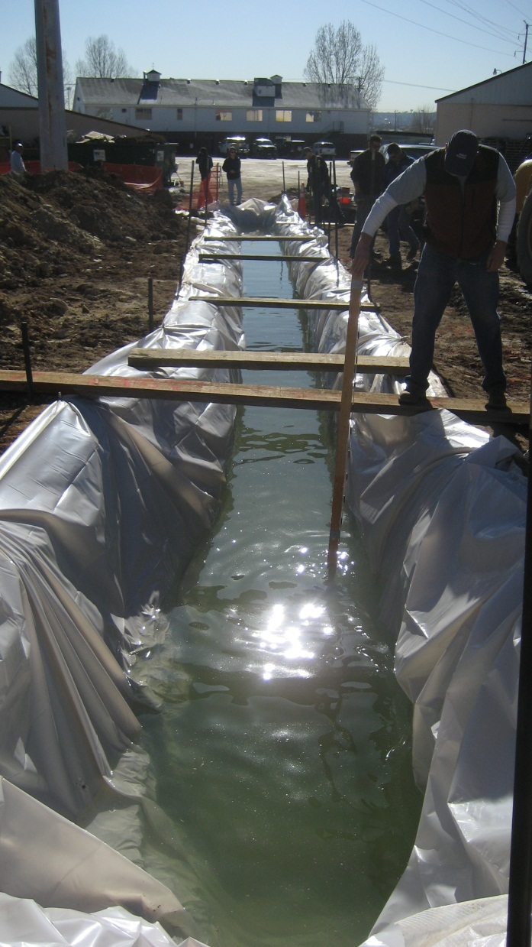
Foam transport has been tested for material delivery underwater
Test Parameters:
Trench cut in test location
70’ long
4’ wide
6’ deep
Material Tremmied in at half way point

Slide 43
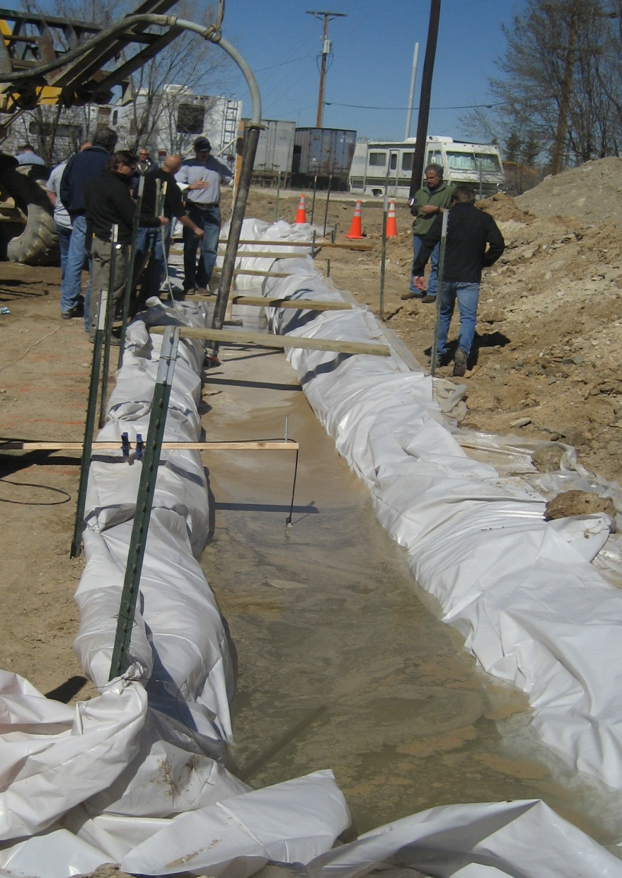
Sanded foam mix moved the entire length of the trench – 35’ each direction from tremie point
Underwater movement of fill material was monitored by Sonar Recording Equipment

Slide 44
Foam transport of materials can provide impactful cost savings
Foam and Fill Material vs. Cement-based grouts
Reduction in energy requirements for pumping and equipment
Reduction in water costs
Lower labor costs from increased production rates vs traditional grouts
Elimination of tailings pond or dewatering

Slide 45
Animation of installation process

Slide 46
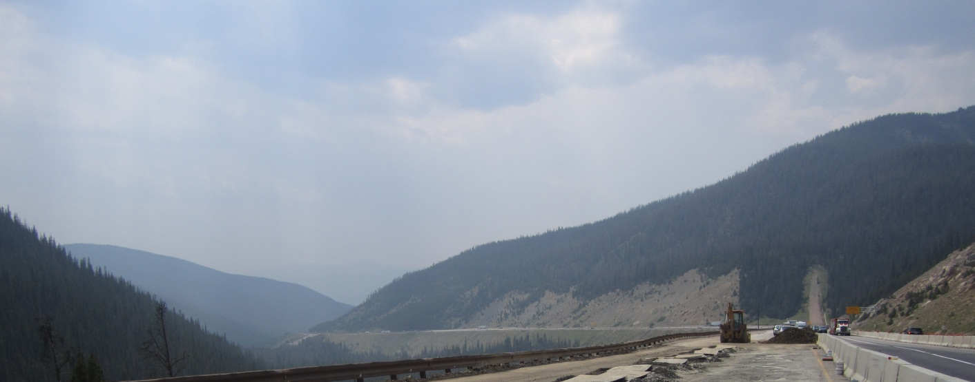
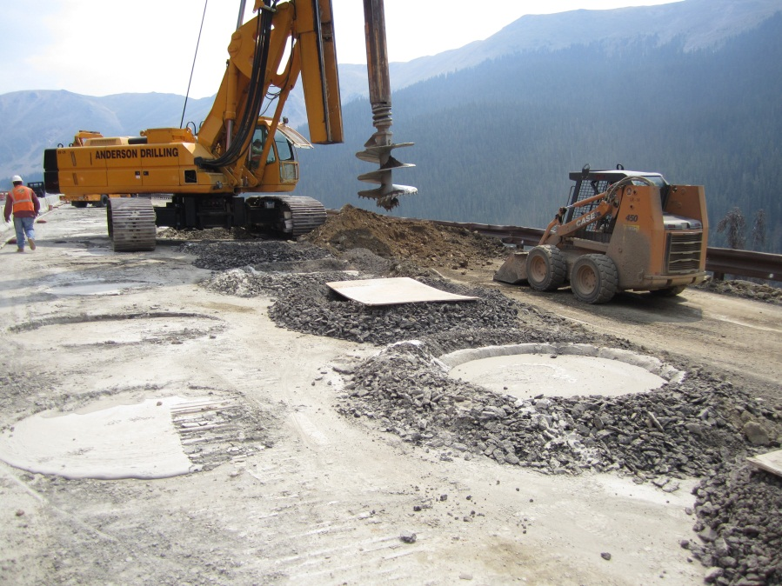
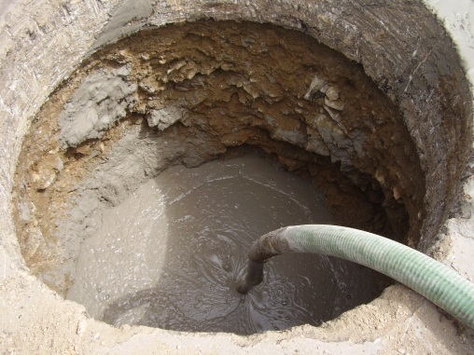
Cellular concrete is always advancing to solve new Grouting challenges
Landslide activity on I-70 between the Eisenhower Tunnel and Silverthorne causes road damage every year. CDOT was looking for a lasting solution other than resurfacing yearly.
A series of 10’-20’ deep columns of lightweight cellular concrete were installed, reducing the dead load on the slip zone and eliminating the subsidence

Slide 47
The low slump mix for this project is progressive for Cellular Concrete technology
The bubble structure remains relatively small even at densities less than 15 pcf
Low slump mix produces stiffer material
Higher placement heights than typical cellular concrete
AASHTO Flow cone test

Slide 48
Beneficial properties of cellular concrete For Grouting Applications
Work-ability
Flow-ability
Thermal insulating
Sound absorption
Energy absorption
Permeability
Strength
Absorbs Energy and Sound
Stability
Self-leveling
Fire resistance
Seismic resistance
Density
Durability
Self-compaction
High freeze-thaw resistance

Slide 49
What conclusions can we draw about cellular concrete?
Broad Range of Densities
Economical
Versatile
Easily Placed
Rapid Installation
Durable
Permanent and Stable
Environmentally Friendly
No One Foam Does it All
We can customize our products to meet your project needs
Questions?

